Slide 1

50.046 Cloud Computing and IoT Lab 1: Set Up the Things
2023 Term 7
TA ZENG Xianzhi

Slide 2
About this Lab
What is the goal?
You are expected to blink the LED on ESP32-CAM/MakePython board by your own code
How to do it
We will first install the ESP tool chain
We will then validate the tool chain is successfully installed
We will lastly use the tool chain to program ESP32 and do the blinking job.

Slide 3
Part1: Install Tool Chain
If you are using windows, then downloading the all-in-one installer is the best way:
https://docs.espressif.com/projects/esp-idf/en/release-v4.3/esp32/get-started/windows-setup.html
Do make sure you are using the 4.3 version
Always say 'yes' and click everything on, unless you exactly know you do not need it
After installation, ESP-IDF Tools Installer also creates a shortcut in the Start menu to launch the ESP-IDF Command Prompt.

Slide 4
Part1: Install Tool Chain
If you are using ubuntu (assuming 22.04), please do the following:
Install dependencies in https://docs.espressif.com/projects/esp-idf/en/release-v4.3/esp32/get-started/linux-setup.html
Follow the Steps 2-4 in https://docs.espressif.com/projects/esp-idf/en/release-v4.3/esp32/get-started/index.html#step-2-get-esp-idf

Slide 5
Part1: Install tool chain
If you are using mac, please do the following:
Install dependencies in https://docs.espressif.com/projects/esp-idf/en/release-v4.3/esp32/get-started/macos-setup.html
Follow the Steps 2-4 in https://docs.espressif.com/projects/esp-idf/en/release-v4.3/esp32/get-started/index.html#step-2-get-esp-idf

Slide 6
Part2: Validate by Hello World
No matter your OS, follow the steps5-7 in https://docs.espressif.com/projects/esp-idf/en/release-v4.3/esp32/get-started/index.html#step-7-configure.
The MakePython board is easier to flash and debug, you can just connect it to computer and follow the guides. But it requires you to manually connect a pin to LED later in Part3.
For flashing ESP32-CAM and hardware connections, please refer to the following pictures.

Slide 7
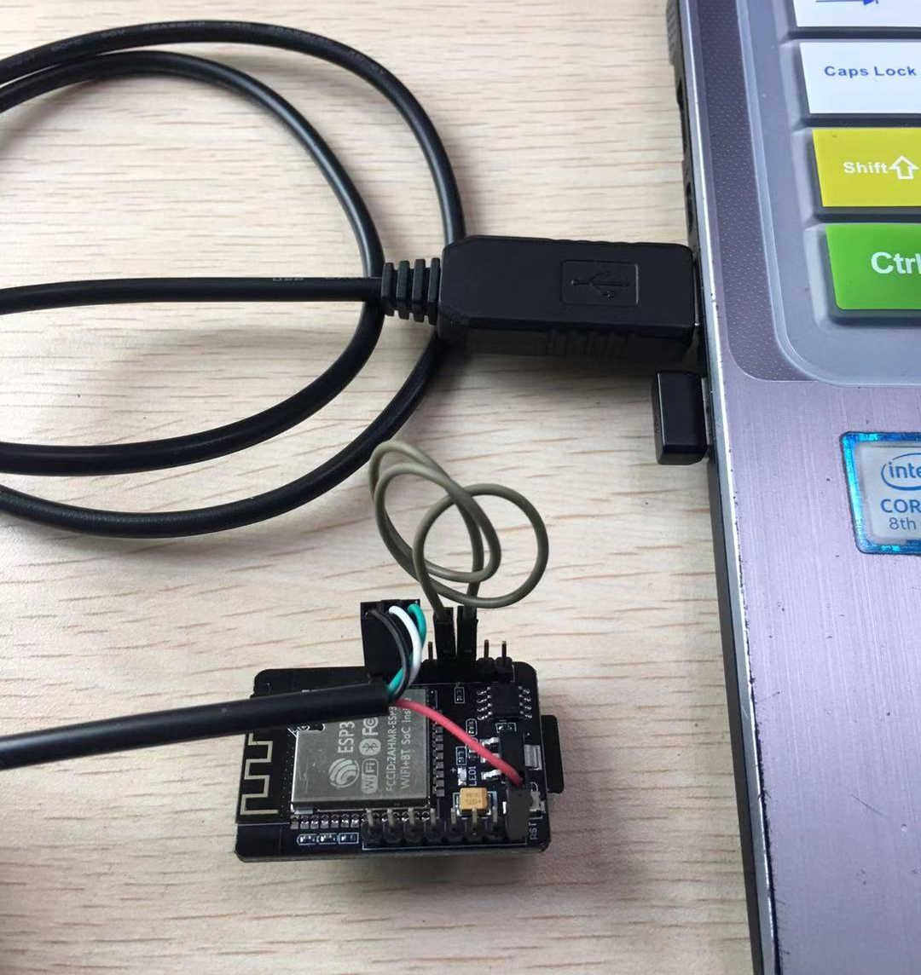
Part2: Validate by Hello World
Before your flashing operation

Slide 8
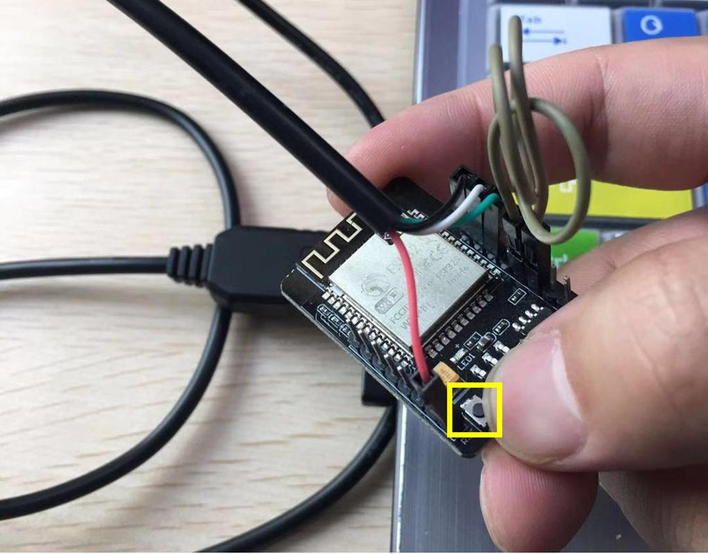
Part2: Validate by Hello World
When seeing the 'connecting' in command line, press the button of reset

Slide 9
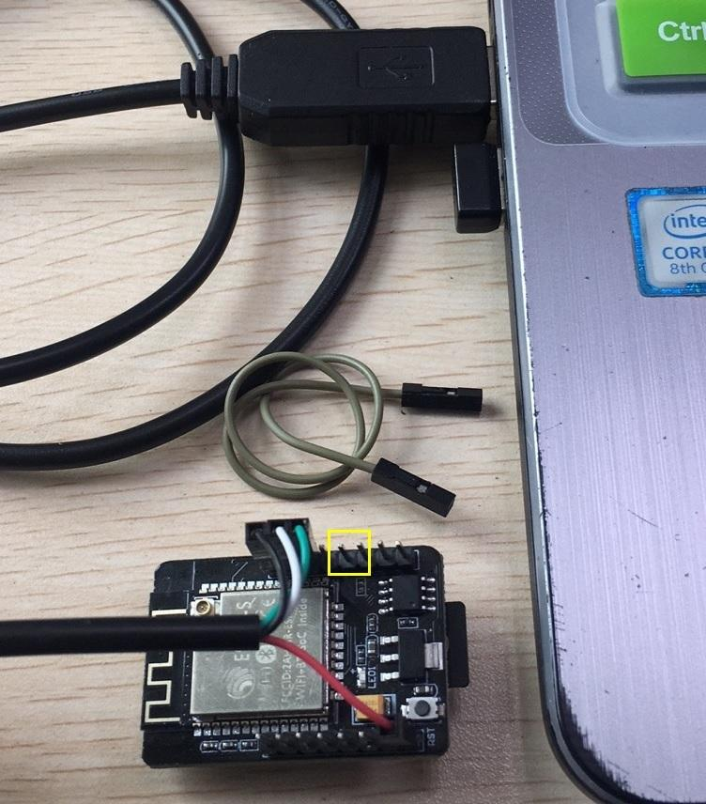
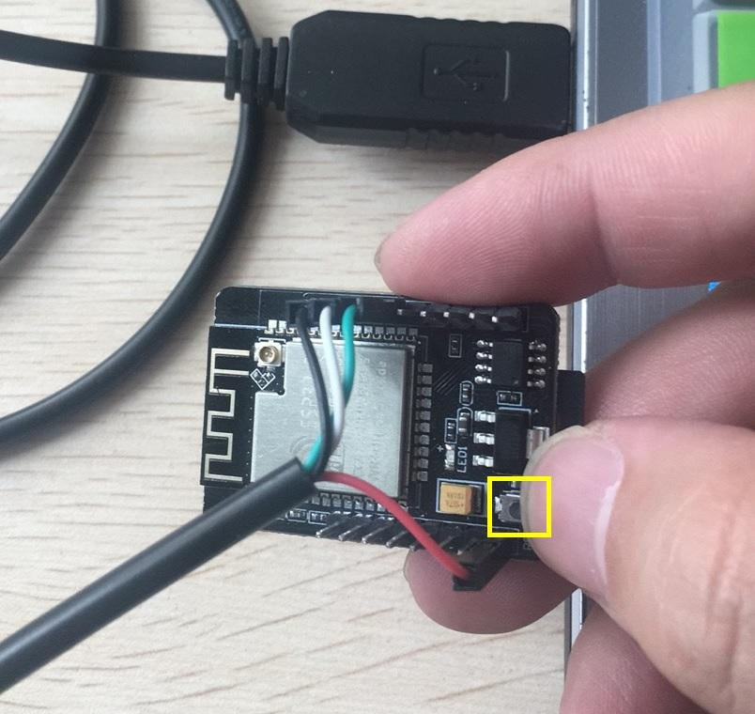
Part2: Validate by Hello World
When flashing is done, do the following
1
2

Slide 10
Part3: Blinky the LED
Here is a suggestion:
Find this example at <Your ESP-IDF PATH>/examples/get-started/blink
2. Try to build and program it to your ESP32, just as what part2 did.
3. Find the blink.c, edit #define BLINK_GPIO CONFIG_BLINK_GPIO into your own led pin. Please type number such as 4 to replace CONFIG_BLINK_GPIO. Then rebuild the project, flash it into ESP32-CAM/MakePython.
(You can also use GPIO_NUM_4 to specify the pin number)
4. Alternatively for 3, you can change the pin number by run menuconfig.
5. Just for fun, you can edit the value in vTaskDelay(1000 / portTICK_PERIOD_MS); and see what will happen...

